Slide 1
Time Series Interpolation Algorithms
Melissa Van Bussel

Slide 2
Want to follow along?
All of the code in this presentation is available on GitHub, and will be displayed on screen as well.

Slide 3
A Crash Course* In Time Series
*A super simplified crash course which lacks full Mathematical depth, but which is presentable in 10 minutes*

Slide 4

Time Series: Definition
A sequence of observations, ${\{X}_{t}\},$one taken at each time t and arranged in chronological order
Stock market predictions, weather forecasting, natural disaster prediction / prevention

Slide 5
Spacing of Observations
Evenly Spaced
Approximately evenly spaced
Missing values
Sampling frequency: the number of observations per cycle (e.g., 12 for 1 observation per month)
Notes:
Can anyone think of data which is ACTUALLY evenly spaced? (Measurements on the hour, every hour)
Can anyone think of another reason why data might have missing values? (Equipment failure)

Slide 6
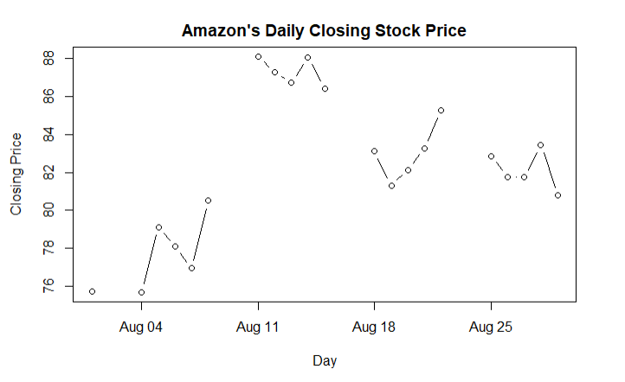
What’s going on here?
library(quantmod)
getSymbols("AMZN", from = "2008-08-01", to = "2008-09-01")
dates <- seq(as.Date("2008-08-01"),
as.Date("2008-08-29"), by = "days")
AMZNdf <- data.frame(dates = dates,
close = rep(NA, length(dates)))
AMZN <- as.data.frame(AMZN)
for (i in 1:length(AMZNdf$dates)) {
index <- which(rownames(AMZN) == AMZNdf$dates[i])
if (length(index) != 0) {
AMZNdf$close[i] <- AMZN$AMZN.Close[index]
}
}
plot(x = AMZNdf$dates, y = AMZNdf$close,
main = "Amazon's Daily Closing Stock Price",
xlab = "Day",
ylab = "Closing Price",
type = "b")

Slide 7
Why else might there be missing values?

Slide 8
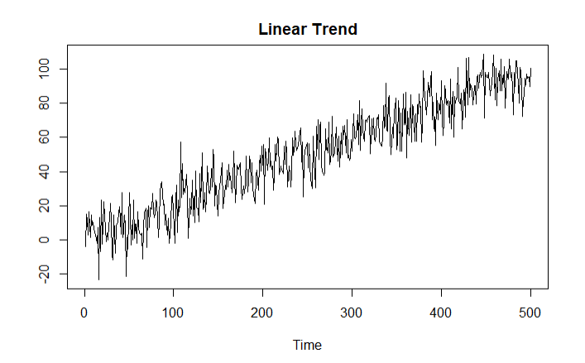
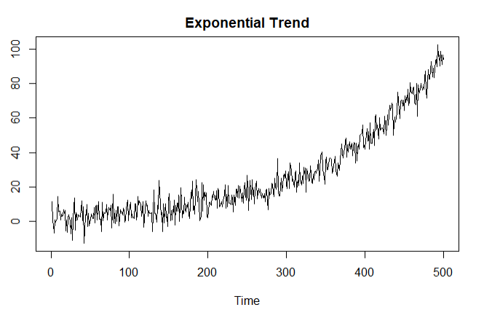
noise <- rnorm(500, 0, 5)
linear <- seq(1, 100, length.out = 500) + noise
plot(linear, type = "l",
main = "Linear Trend", ylab = "", xlab = "Time")
noise <- rnorm(500, 0, 5)
time <- seq(1, 5, length.out = 500)
exponential <- 2.5 ^ time + noise
plot(exponential, type = "l",
main = "Exponential Trend",
xlab = "Time",
ylab = "")

Slide 9
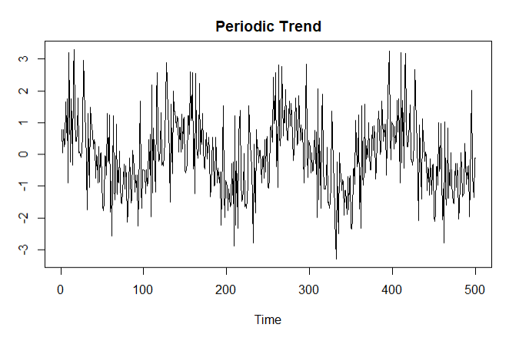
noise <- rnorm(100, 0, 1)
periodic <- sin(seq(1, 25, length.out = 500)) + noise
plot(periodic, type = "l",
main = "Periodic Trend",
xlab = "Time",
ylab = "")

Slide 10
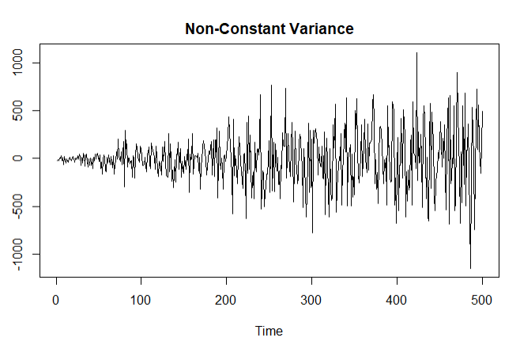
Non-Constant Variance
The variance of a series can experience a trend as well.
noise <- rnorm(500, 0, 5)
non_const_var <- seq(1, 100, length.out = 500) * noise
+ noise * 2
plot(non_const_var, type = "l",
main = "Non-Constant Variance",
xlab = "Time",
ylab = "n")

Slide 11
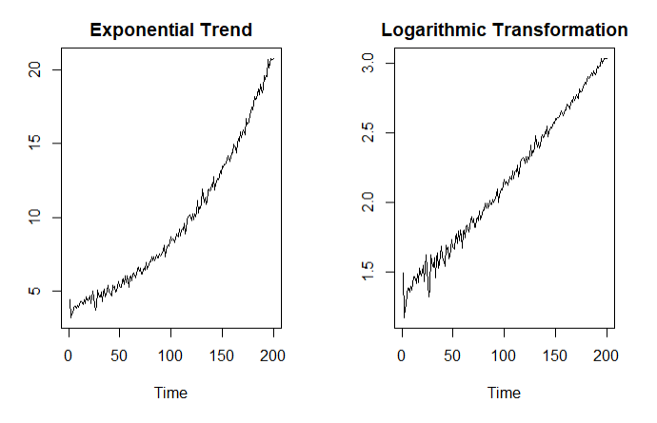
Transformations
noise <- rnorm(200, 0, 0.25)
time <- seq(1, 3, length.out = 200)
exponential <- exp(time) + noise + 1
par(mfrow = c(1, 2))
plot(exponential, type = "l",
main = "Exponential Trend",
xlab = "Time",
ylab = "")
plot(log(exponential), type = "l",
main = "Logarithmic Transformation",
ylab = "",
xlab = "Time")
Notes:
Often, we wish to remove trends. We can do so by transforming our series.

Slide 12
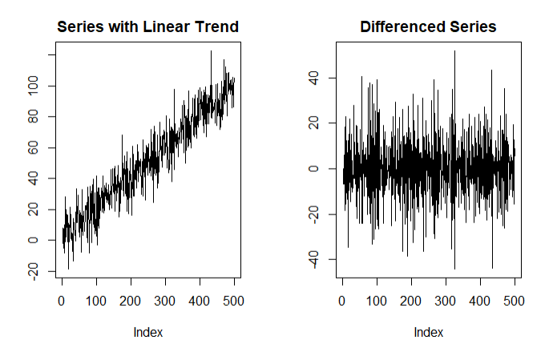
Differencing
Differencing refers to taking the difference between two consecutive observations
A differenced series will have one less observation than the original series
Removes linear trends
noise <- rnorm(500, 0, 5)
linear <- seq(1, 100, length.out = 500) + wn * 2
differenced <- diff(linear)
par(mfrow = c(1, 2))
plot(linear, type = "l",
main = "Series with Linear Trend",
ylab = "")
plot(differenced,
main = "Differenced Series",
type = "l",
ylab = "")

Slide 13
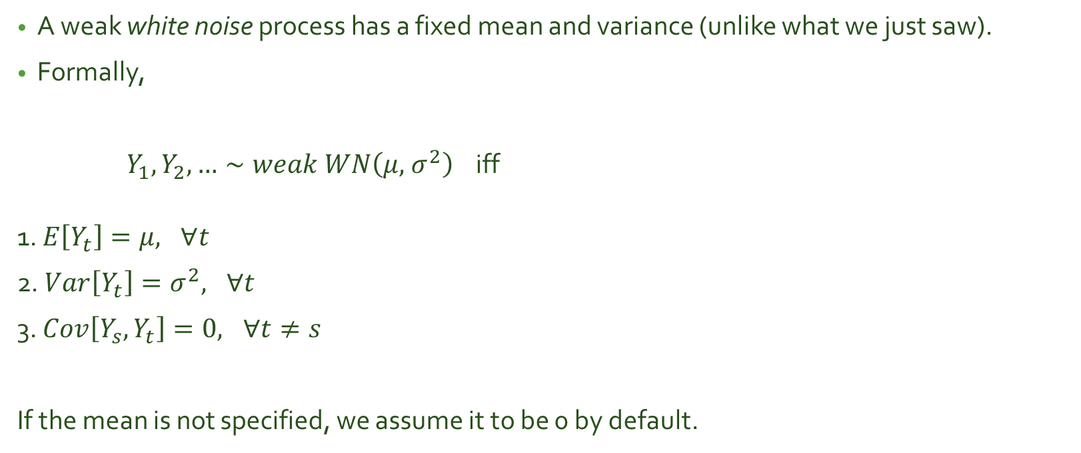
White Noise Processes
A weak white noise process has a fixed mean and variance (unlike what we just saw).
Formally,
${ Y}_{1},Y_{2},…∼weak WN\left(μ,{ σ}^{2}\right)$ iff
1. $E\left[Y_{t}\right]=μ, ∀t$
2. $Var\left[Y_{t}\right]=σ^{2}, ∀t$
3. $Cov\left[Y_{s}, Y_{t}\right]=0, ∀t≠s$
If the mean is not specified, we assume it to be 0 by default.
*IID white noise processes have additional requirements.

Slide 14
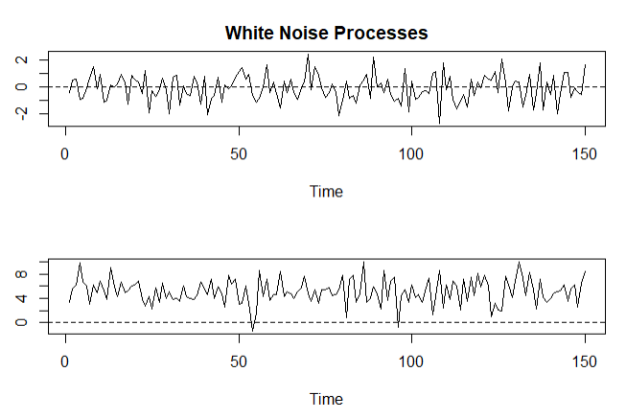
library(forecast)
wn1 <- arima.sim(model =
list(order = c(0, 0, 0)),
n = 150)
wn2 <- arima.sim(model =
list(order = c(0, 0, 0)),
n = 150,
mean = 4,
sd = 2)
par(mfrow = c(2, 1))
plot(wn1, main = "White Noise Processes",
ylab = "")
abline(h = 0, lty = 2)
plot(wn2 + 1, ylab = "")
abline(h = 0, lty = 2)

Slide 15
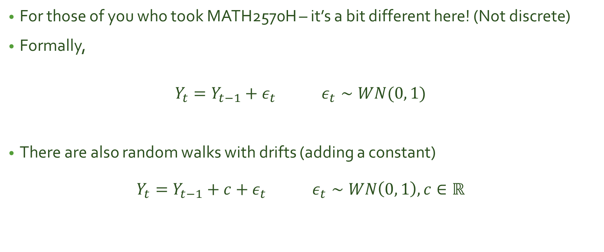
Random Walks
For those of you who took MATH2570H – it’s a bit different here! (Not discrete)
Formally,
$$Y_{t}=Y_{t−1}+ε_{t} ε_{t}∼WN(0, 1)$$
There are also random walks with drifts (adding a constant)
$$Y_{t}=Y_{t−1}+c+ε_{t} ε_{t}∼WN\left(0, 1\right), c∈ℝ$$

Slide 16
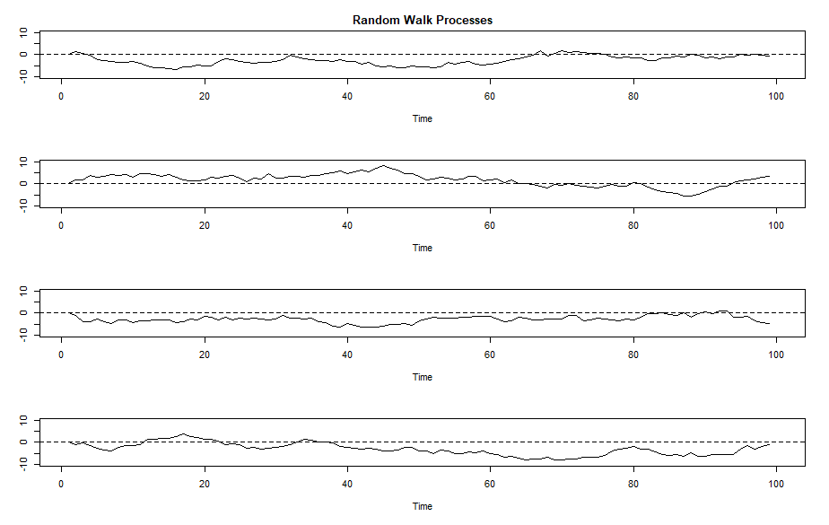
*Code omitted due to length

Slide 18
Random Walks, White Noise, and Differencing
Differencing a random walk will produce a white noise process.
For a random walk with a drift, the difference becomes a

Slide 19
Stationary vs. Non-Stationary Processes

